Slide 1

Under the supervisors of:
Dr. Ehab Ezzat
TA. Nehal Ahmed

Slide 2
Glucoguide’s TEAM
Shrouk Ahmed
20200250
Mai Tarek
20201182
Abdallah Mahmoud
20200307
Abdelrahman Nasser
20200296
Sohila Mahmoud
20200235
Hiba Kamal
20200860
1

Slide 3
agenda
01
02
Introduction
motivation
03
objectives
04
05
Functional requirements
Non functional requirements
2

Slide 4
Agenda (cont..)
06
07
08
Related work
difference
technologies
09
10
11
Demo video
conclusion
Future work
3

Slide 5
INTRODUCTION
Our project empowers diabetics to take care of their health easily through A comprehensive and user-friendly web application. Users could do the following:
predict if they have diabetes or not.
Read multifaceted approach articles.
Make multifaceted health lists.
5

Slide 6
motivation
Managing diabetes requires lifestyle changes, regular blood glucose monitoring, medication adherence, and staying informed about diabetes care advancements.
GlucoGuide was developed to provide a comprehensive, user-friendly solution for effective diabetes management, empowering individuals to take control of their health.
11

Slide 7
Objectives
Design and implement machine learning algorithms capable to identify who is most likely to have diabetes.
Upload health data around a period of time to see a graph of his of his health around this time.
Create a health list of each user to help him in manage and schedule his medicines
Improving GlucoGuide's educational materials to offer current knowledge on diabetes prevention, management, and lifestyle changes.
Improving the user interface of GlucoGuide to ensure an easy navigation and interaction with the system.
14

Slide 8
Functional requirements
User registration and authentication ( sign up, sign in )
Early prediction of diabetes
View healthcare articles (e.g., medical reports, lifestyle tips…)
Search within articles
Creating a several type of health lists (ex. glucose measures times, medication schedules..)
17

Slide 9
Functional requirements (cont..)
Upload and store medical record (glucose measures, insulin levels, Carbohydrate...)
Provide a statistics graph ( visualization of medical record over time )
Use a locator tool ( nearest clinics or pharmacies )
Add review
18

Slide 10
Functional requirements (cont..)
Admin registration and authentication ( log in )
Publish articles about healthcare (e.g., medical reports, lifestyle tips...)
Notify users when articles are published
Manage reviews (reply , delete...)
19

Slide 11
Non-functional requirements
Security
Robustness
Performance
Authentication: User identity verification
Data Privacy: users can only access their own data
Handling bad user inputs and wrong data
Minimum response time of 5 seconds and quick response
Dealing with a large volume of users and data
Usability
Scalability
Intuitive and user-friendly interface
Clear navigation and easily accessible features
Ability to handle increased traffic and resource demands
21

Slide 12
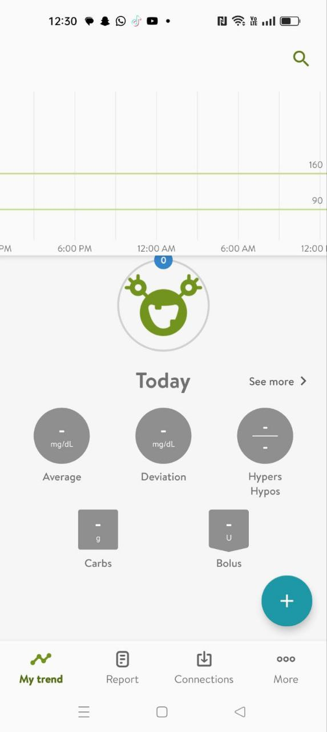

Related Work
Mysugar App
DIAbetes digital health App
This app helps users track their blood sugar levels, carbohydrate intake, and insulin doses. It also provides insights and trends to better understand and manage diabetes.
Glooko syncs with various blood glucose meters, insulin pumps, and continuous glucose monitors to track blood sugar levels and other diabetes-related data. It also provides analytics and insights for better management.
23

Slide 13
Our differences
Integration with Providers: Seamless integration with healthcare providers.
Customer Support: Users can make reviews, and admins can reply.
Topic Search: Search functionality for specific health topics.
Diabetes Prediction: Initial prediction of diabetes at app startup.
Location Services: Provides locations of drugstores, clinics, and restaurants.
Medication Schedule: Users can create their own medication schedules.
25

Slide 14
Technologies
Front end
React
HTML + CSS + JAVASCRIPT
Back end
Java
Spring Boot framework
MySQL for database
27

Slide 15
Technologies
Algorithm | Accuracy
Logistic Regression | 85%
Decision Trees | 90%
Support Vector Machines (SVM): | 92%
Random Forest | 95%
Machine Learning
Python + Flask + sKlearn pandas
Data Used:
Dataset: Early-Stage Diabetes Risk Prediction
Source: UCI Machine Learning Repository
Algorithm Used:
For this classification problem we use Random Forest algorithm
28

Slide 16
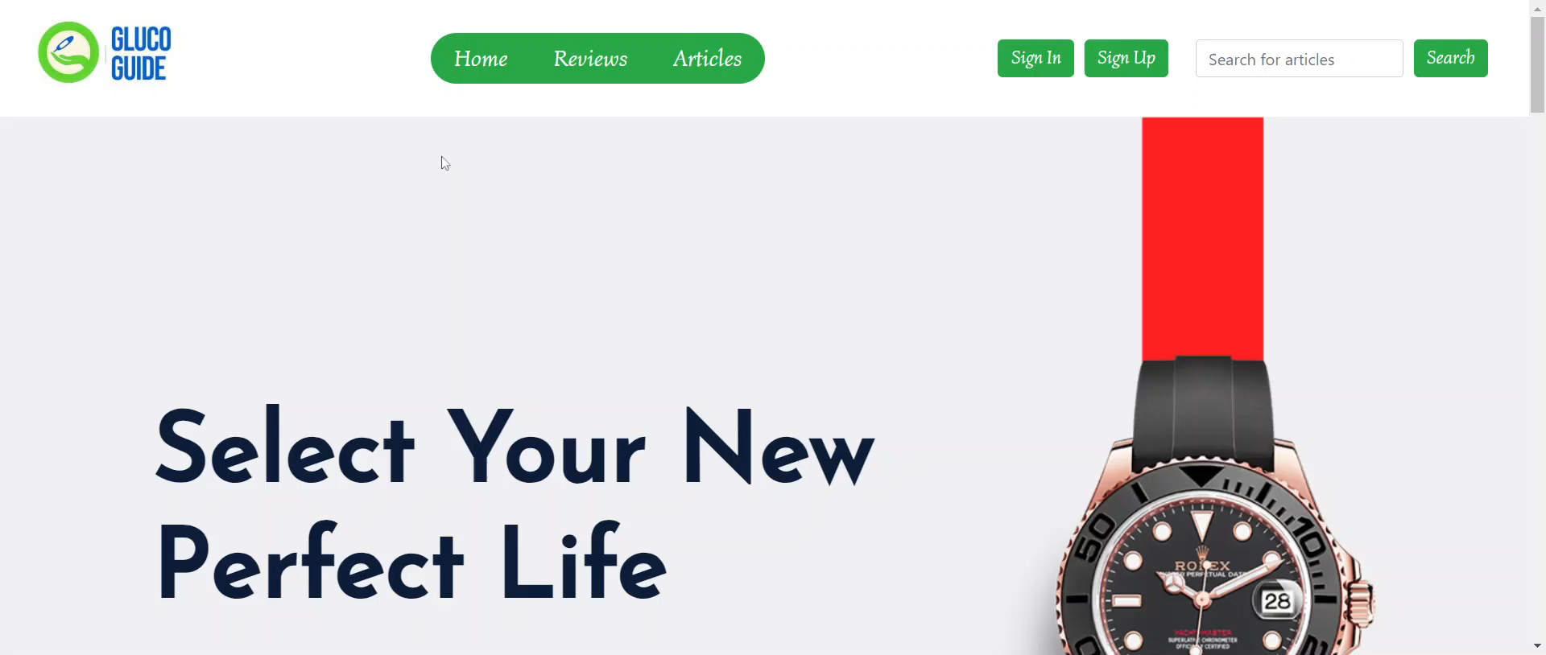
41

Slide 17
CONCLUSION
Our objective is to create a user-centric platform that aids in managing diabetes. This system will enable patients to monitor their health status regularly, stay informed about the latest and most significant health articles, prevent them from excessive worrying about their illness, and continue leading healthy lives.
44

Slide 18
Future work
Mobile Application Development: Create a mobile app for on-the-go access to GlucoGuide features.
Advanced Machine Learning Models: Develop sophisticated models for accurate predictions and personalized health insights.
Expanded Language Support: Increase the number of supported languages to cater to a diverse user base.
Enhanced Device Integration: Improve compatibility with more health monitoring devices for real-time data tracking.
Community Engagement Features: Introduce forums, chat rooms, and support groups for user interaction and support
25

Slide 19
thanks!
Any questions?
45

Slide 20
References
World Health Organization
IDF Diabetes Atlas
Diabetes Federation
Early-Stage Diabetes Risk Prediction Dataset
Dr.Neamat khider
Family medicine
6. Dr.Sara Isameldin
Public health specialist
46

